Slide 1
Copyright Exceptions and Images for Educational Use Ann Ludbrook, Ryerson University Jan. 31st, 2014

Slide 2
s30.04 : Work available through Internet & images
New Copyright exception as of
2012 for educational use only
Must be on the public Internet
No amount limit, educational use only
Not protected by passwords or digital locks
To the best of your knowledge must be legally posted

Slide 3
s30.04 : Work available through Internet & images
What is a “clearly visible notice”?
© sign alone is not is sufficient
Governor in Council may at some future time make regulations prescribing what defines this
At this time this can be broadly interpreted

Slide 4
Clearly visible on page
No notices at all on page
ok to reuse right on page
terms do not prohibit non-commercial or educational reuse or redistribution or material
Do not link to a clear licence/reuse button or amount restriction

Slide 5
s30.04 : What about Terms of Use
Must be easily decipherable
Not a laundry list with reuse of material rules buried
Should be on first screen or readily visible within the first page and in very clear language (not legalese)
What about single use or “private” notice?

Slide 6
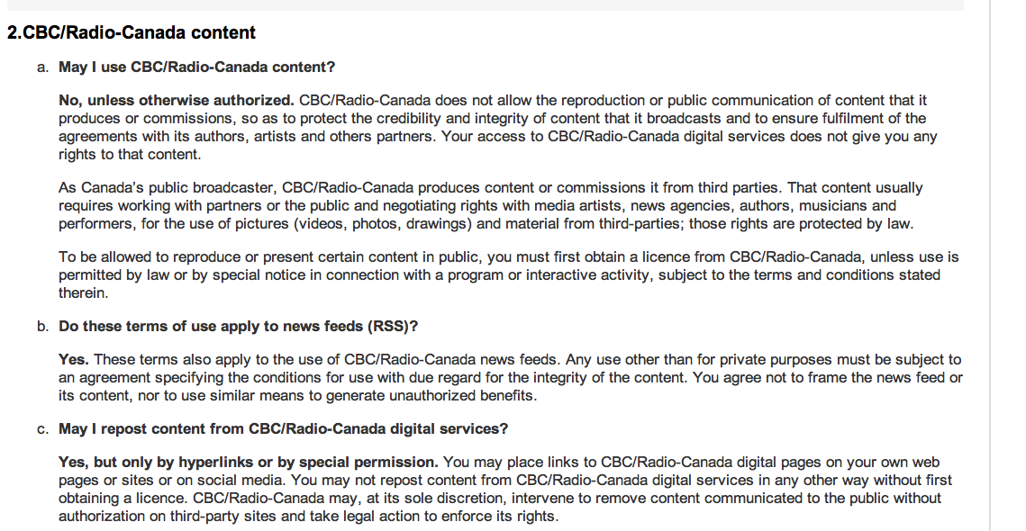
Terms of Use: CBC

Slide 7
Links to Copyright Statements

Slide 8
Licence options example : Globe & Mail
Print/license notice on
page
Clear notice on article
when going
into print option:
Permission granted for up to 5 copies. All rights reserved. You may forward this article or get additional permissions by typing http://license.icopyright.net/3.8425?icx_id=16604931 into any web browser.

Slide 9
Fair Dealing Policies & Images
10% of a work or one chapter – images in context are fine
OR
One image from a work (artistic)
BUT
More 10% of images on case to case basis i.e. course book adoption (ask your copyright contact)

Slide 10
Mash-up Exception: Images
Only copyright exception for user generated content in the world
“personal” use only
Can use for student postings (podcasts) and posted on the web
Must be transformational (mashed-up)
Can’t be used by faculty for teaching
Fair dealing is usually as expansive except in the case of a whole song
Must legally obtain content

